Slide 1
Automating (Meta)Data Transfer to Coscine
Catherine Gonzalez
Data Steward
CRC-1382/NFDI4Microbiota
Helpers: Jonathan Hartman
Data Scientist/Consultant
DKZ.2r
Notes:
Thank you for joining us today for this workshop. I‘m Catherine or you can call me Cat. I‘m the data steward with the CRC 1382 Gut-Liver Axis and NFDI4Microbiota.

Slide 2
Guidelines
Use welcoming and inclusive language
Be respectful of different viewpoints and experiences
Gracefully accept constructive criticism
Focus on what is best for the community
Show courtesy and respect towards other community members
Questions are encouraged—just raise your hand
Notes:
First I‘d like to review some guidelines.

Slide 3

Course Objectives
Know what options are available that we can use to interface with Coscine
Be able to write simple python code to fill in metadata and send it to Coscine
Be able to write a Python script
That automatically extracts metadata from a file
Fills in the metadata form
Send the file and the metadata to Coscine
(Meta)Data
Python
Notes:
Our objectives as stated in the workshop description will be to..
Know what options you have to interface with Coscine. Which are:
(Web UI)
(REST API)
Coscine Python SDK

Slide 4
Expectations
Basic introduction
Python Coverage
Live Coding

Slide 5
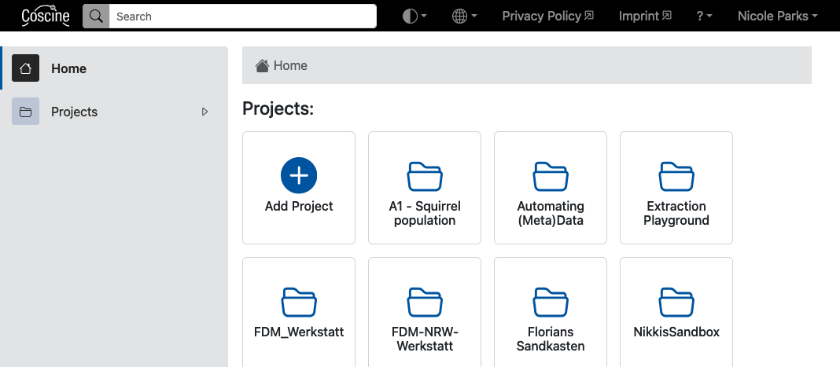
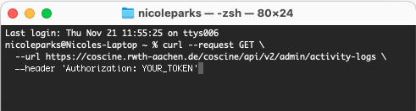
Interfacing with Coscine
Coscine
Web UI
REST API
Coscine Python SDK
import coscine
coscine_client = coscine.ApiClient(TOKEN)
project = cos_client.project(PROJECT_NAME)
resource = project.resource(RESOURCE_NAME)
metadata = resource.metadata_form()
metadata[key] = value
cURL
Notes:
Coscine employs a REST API, an application programming interface, which allows you to interact with the data and metadata store in various ways.
The Web UI is one example of interfacing with Coscine–and it uses the API in the background.
You can use command line tools such as cURL to write and send requests, interacting with the API directly.
And you can use the Coscine Pythion SDK (Software Development Kit), which allows you to interact with Coscine through the API in a more Pythonic way. Aside from being familiar to Python programmers, it is similar to the web UI, in that it offers and easier way to deal with metadata, allowing you to use a fillable, dictionary-like form.
(A REST API, short for Representational State Transfer Application Programming Interface, is an architectural style guiding the design and interaction of web services. It utilizes standard HTTP methods and is often paired with JSON or XML for data representation.)

Slide 6
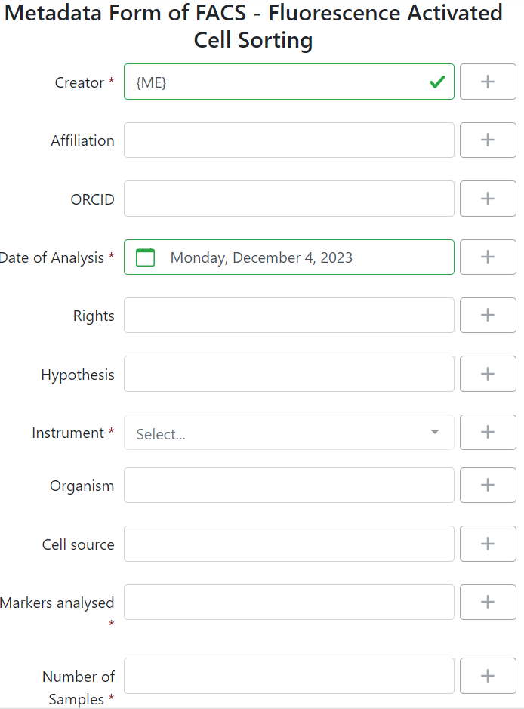
Metadata Profiles
Can be extensive
Time consuming
Let’s look at the resource in Coscine:
https://coscine.rwth-aachen.de/
Notes:
Metadata profiles may be familiar if you have attended the last workshop in the series or if you have used Coscine already.
Metadata profiles can be extensive and include many fields that would be quite time consuming to fill out manually.
For today you should all have received an invite to the project Automating (Meta)data.
Our resource called “Text” which we will be working with contains the Base AP so it is small and easy to manage.
We also will be working with a resource “Test Images” that is just the Base AP that was extended.

Slide 7
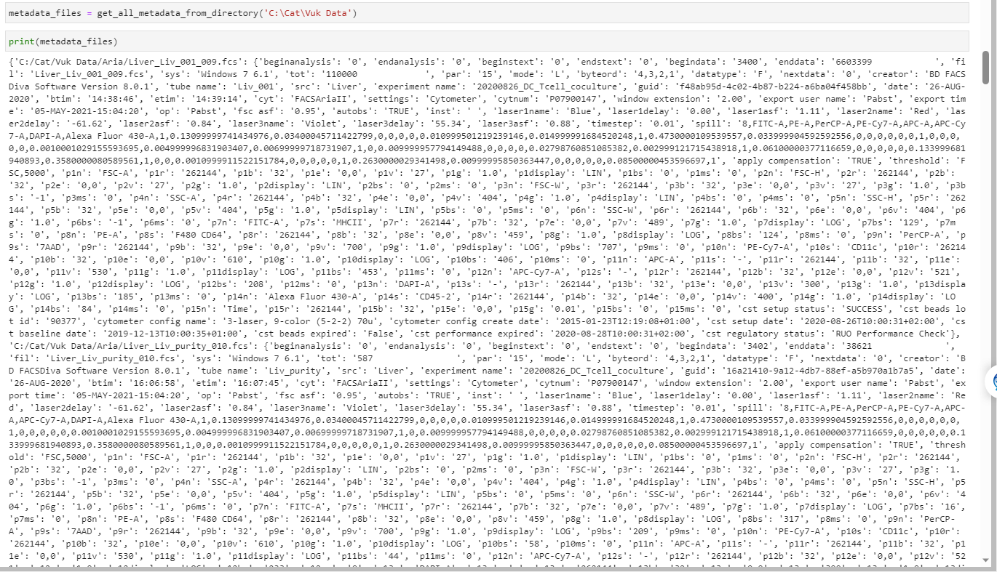
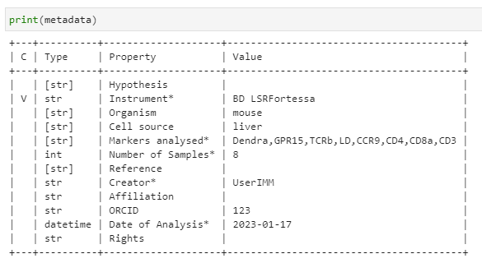
Automating Workflows
Notes:
Our goal with using the Python SDK and Coscine is to create automated workflows for researchers. With an automated RDM workflow, researchers can FAIRLY store data and metadata is an quick and easy way.
While there is some initial effort/time investment that‘s needed to write Python scripts this ultimately saves the researcher time.
For example, this is a flow cytometry file which appears as a dictionary with key, value pairs. Using Python we can extract the only the necessary values from the file and fill the metadata form. We can then send the file and the completed metadata form to Coscine. So if you go to Coscine you will see that this metadata form is now linked with the file.
So this is what we are going to learn how to do today. Now we‘ll get started with coding.
Here is the link to our Github repository: catgonzftw1/MetadataTransferRDMII (github.com)

Slide 8
Today’s recap
Created and read a configuration file
Used the Coscine Python SDK to connect the Coscine REST API
Filled in the metadata form for a file in Coscine
Uploaded a file and the metadata via the REST API
Created a directory structure in Coscine
Extracted metadata from a file and transferred the metadata + file to Coscine
Notes:
To summarize the workshop we…
Please remember to complete the survey for the course and let us know how you felt about it.

Slide 9
Resources
Coscine/Python Script Examples:
https://coscine.pages.rwth-aachen.de/community-features/coscine-technical-adaption/
Coscine API Documentation:
https://coscine.rwth-aachen.de/coscine/apps/apidocs/#tag/admin
Python SDK Documentation:
coscine 0.11.12 documentation (rwth-aachen.de)

Slide 10
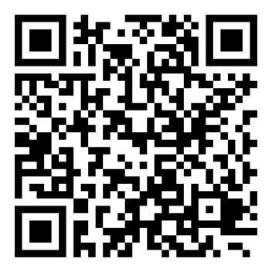
Catherine Gonzalez
CRC-1382
Data Steward
c.gonzalez@itc.rwth-aachen.de

